Slide 1

DEPARTMENT OF PHYSICS
SRM INSTITUTE OF SCIENCE AND TECHNOLOGY
18PYB103J –Semiconductor Physics
Concepts of optical transition in bulk semiconductor

Slide 2
For the optical properties of semiconductors, the photons should interact with charge carriers.
In the process of interaction three process occurs
Absorption
Recombination
Emission
i.e the photons are absorbed and emitted , these processes are important in photonic
devices using semiconductors
There are several type of transition possibilities are occur
Band to band transition (Inter band transition)
Impurity level to band transition
Free carrier transition (Intra band transition)

Slide 3

In semiconductors electrons can make transitions between two energy states and create or destroy photons in the process.
1. Band to band transition (Inter band transition)
An absorbed photon can result in an electron in the valence band making an upward transition to conduction band. This results electron-hole pair generation, followed by this electron-hole recombination takes place by the emission of Photon
Eg: Band to Band transition in GaAs can results absorption and emission of photons with wavelength of 0.087 µm or (E_{g} = 1.42 eV)

Slide 4
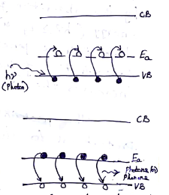
2. Impurity level to band transition:
An absorbed photon results in a charge carriers transition between a donor (or) acceptor level to a band in semiconductor, mostly observed in doped semiconductors.
For example if a p-type material is considered, the low energy photon absorbed by p-type semiconductor material leads transition of electron from valence band to acceptor level where its trapped by acceptor atom. Thus hole is created in Valence band and acceptor atom is ionized.
Similarly a hole may be trapped by an ionized acceptor atom. The result may be the electron decay from its acceptor level to recombine with hole. The energy may be released radiatively (photons) or non-radiatively (phonons)
Eg: In Hg doped Ge thw wavelength of absorption and emission between valence and conduction band is 14 µm

Slide 5
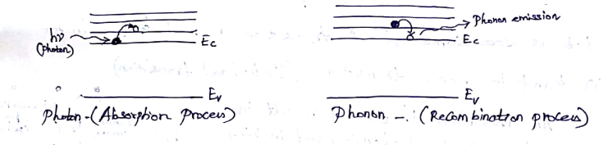
3. Free carrier transition (Intra band transition):
An absorbed photon can impart its energy to an electron in a given band, causing it to move higher
level in that band. If a lower level conduction band is considered, by absorbing photon energy the electron moves to next higher energy level in the same conduction band.
Similarly due to thermalization, electron relaxes down to the bottom of the conduction band while releasing its energy in the form of phonons.

Slide 6
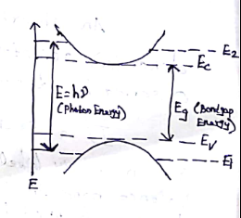
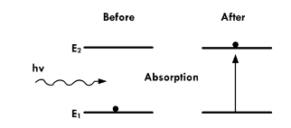
Optical absorption process :
Absorption is the process in which the photons are absorbed by the semiconductor
materials causes transition of electron from valence band to conduction band.
Consider direct band to band absorption
The condition for absorption to happen, the incident photon energy must be equal
Or greater than the bandgap i.e hν ≥ Eg, corresponding wavelength λ = hc/Eg.
The electron hole pairs are generated due to absorption of photon having energy grater
Or equal to bandgap.
This leads to the increase of concentration of mobile charge carriers and increase the
Conductivity of the material.
So the material behaves as a photoconductor with a conductivity proptaional to photon
Flux, the effect is used to detect light.

Slide 7
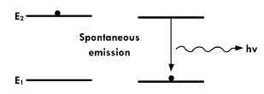
Emission process:
Generally the emission process are takes place in two types in optical devices
Spontaneous emission
Stimulated emission
Spontaneous emission: spontaneous emission, this process requires a conduction band
energy state occupied by an electron and an empty valence band energy state. The electron Itself transit from conduction band to valence band spontaneously by releasing a photon.
This photon has a random direction and phase.
This is the opposite of the common situation in equilibrium, but at a finite temperature
there will be a small number of full states in the conduction band and empty states in the
valence band. Also, electrons and holes can be created via optical absorption and other
pumping mechanisms.

Slide 8
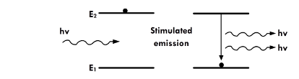
Stimulated emission:
An incident photon causes an upper level atom to decay, emitting a “stimulated” photon whose properties are identical to those of the incident photon.
The term “stimulated” underlines the fact that this kind of radiation only occurs if an incident photon is present

Slide 9
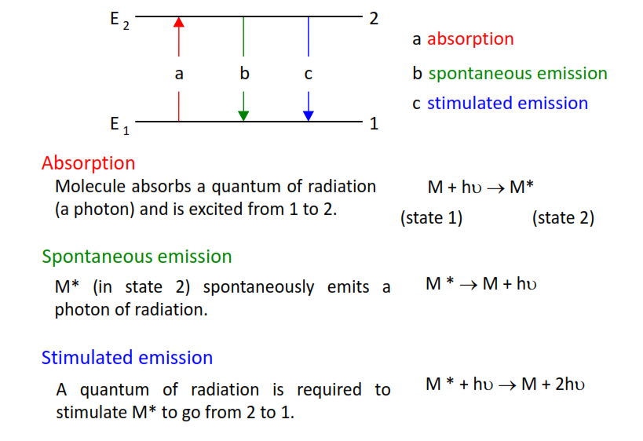
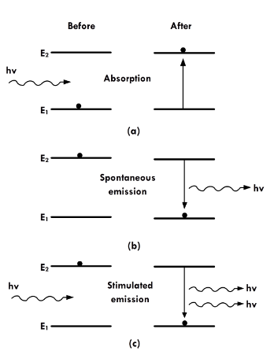
Over all picture of Absorption and emission process

